Slide 1
CEGE0004: Machine Learning for Data Science Lecture 6: Model Ensembles Dr. Aldo Lipani

Slide 2
Model Ensembles
Instead of learning one model, learn several and combine them.
This typically improves accuracy by a lot.
Very much used in industry.
Ensemble methods:
Stacking;
Bagging;
Random Forest;
Boosting;
AdaBoost;
ECOC (Error-Correcting Output Coding).

Slide 3

Stacking
Apply multiple base learners with various hyper-parameters: e.g., decision trees, naïve Bayes, neural nets, etc.
Meta-learner learns to predict based on the output of the other classifiers.
Training by leave-one-out cross validation.
classifier 1
classifier 2
meta-learner
$$…$$
classifier n

Slide 4

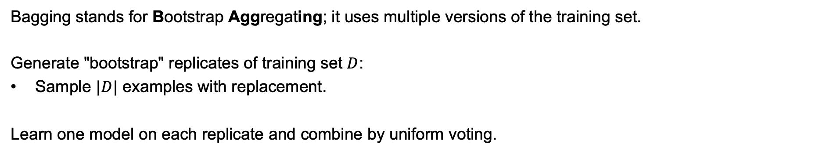

Bagging
Bagging stands for Bootstrap Aggregating; it uses multiple versions of the training set.
Generate "bootstrap" replicates of training set $D$:
Sample $|D|$ examples with replacement.
Learn one model on each replicate and combine by uniform voting.
classifier 1
classifier 2
voting
$$…$$
$$…$$
classifier n

Slide 5
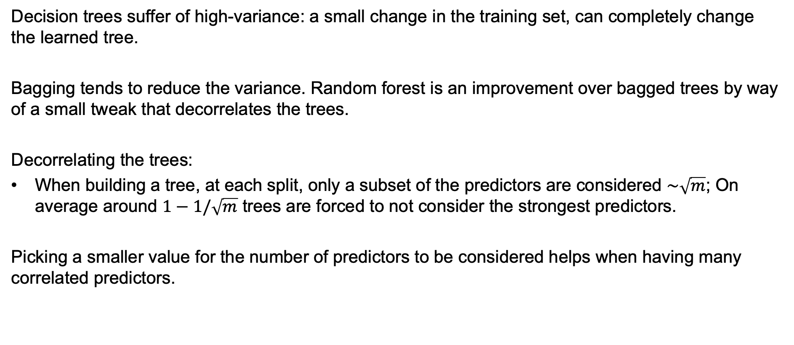
Random Forest
Decision trees suffer of high-variance: a small change in the training set, can completely change the learned tree.
Bagging tends to reduce the variance. Random forest is an improvement over bagged trees by way of a small tweak that decorrelates the trees.
Decorrelating the trees:
When building a tree, at each split, only a subset of the predictors are considered $\sim \sqrt{m}$; On average around $1−1/\sqrt{m}$ trees are forced to not consider the strongest predictors.
Picking a smaller value for the number of predictors to be considered helps when having many correlated predictors.

Slide 6

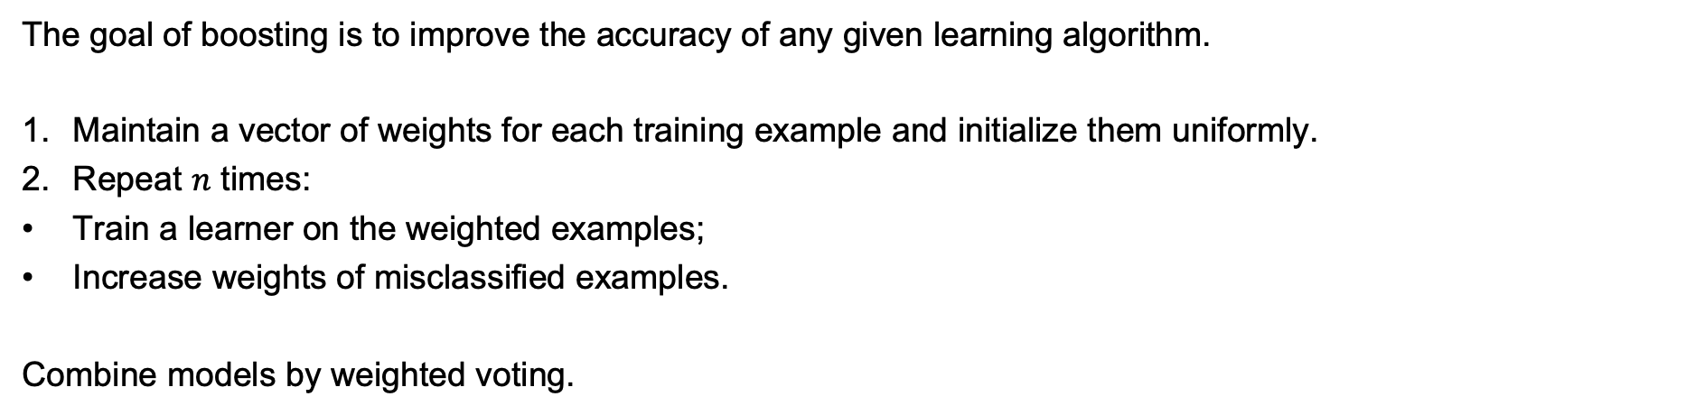
Boosting
The goal of boosting is to improve the accuracy of any given learning algorithm.
Maintain a vector of weights for each training example and initialize them uniformly.
Repeat $n$ times:
Train a learner on the weighted examples;
Increase weights of misclassified examples.
Combine models by weighted voting.
classifier 1
classifier n
combine
$$…$$

Slide 7
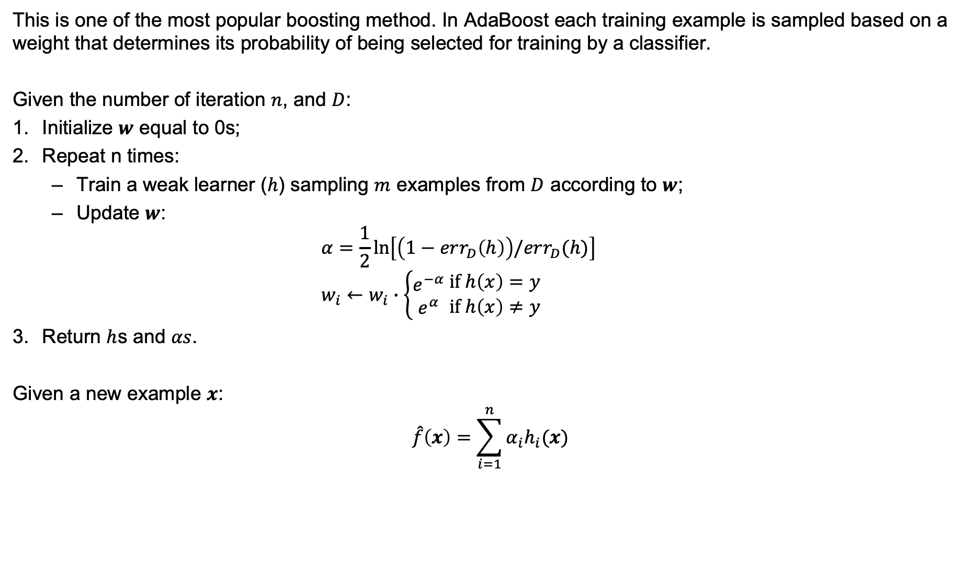
AdaBoost
This is one of the most popular boosting method. In AdaBoost each training example is sampled based on a weight that determines its probability of being selected for training by a classifier.
Given the number of iteration $n$, and $D$:
Initialize $w$ equal to 0s;
Repeat n times:
Train a weak learner ($h$) sampling $m$ examples from $D$ according to $w$;
Update $w$: $α=\frac{1}{2}\ln\left[\left(1−err_{D}\left(h\right)\right)/err_{D}(h)\right]$ $w_{i}←w_{i}∙\left\{\begin{aligned}e^{−α} \\ e^{α}\end{aligned} \begin{matrix}if h\left(x\right)=y \\ if h\left(x\right)≠y\end{matrix}\right.$
Return $h$s and $αs$.
Given a new example $x$:
$$\hat{f}\left(x\right)=\sum_{i=1}^{n}{α_{i}h_{i}(x)}$$

Slide 8
Error-Correcting Output Coding
The ECOC method allows to reframe a multi-class classification problem as a multiple binary classification problem.
Unlike one-vs-rest (OvR) or one-vs-one (OvO) methods:
OvR splits a multi-class problem into one binary problem per class.
OvO splits a multi-class problem into one binary problem per each pair of classes.
ECOC offers another solution to this problem.

Slide 9
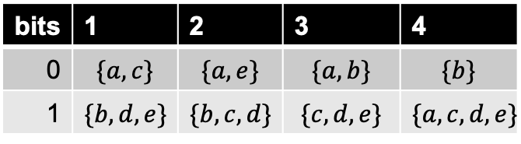
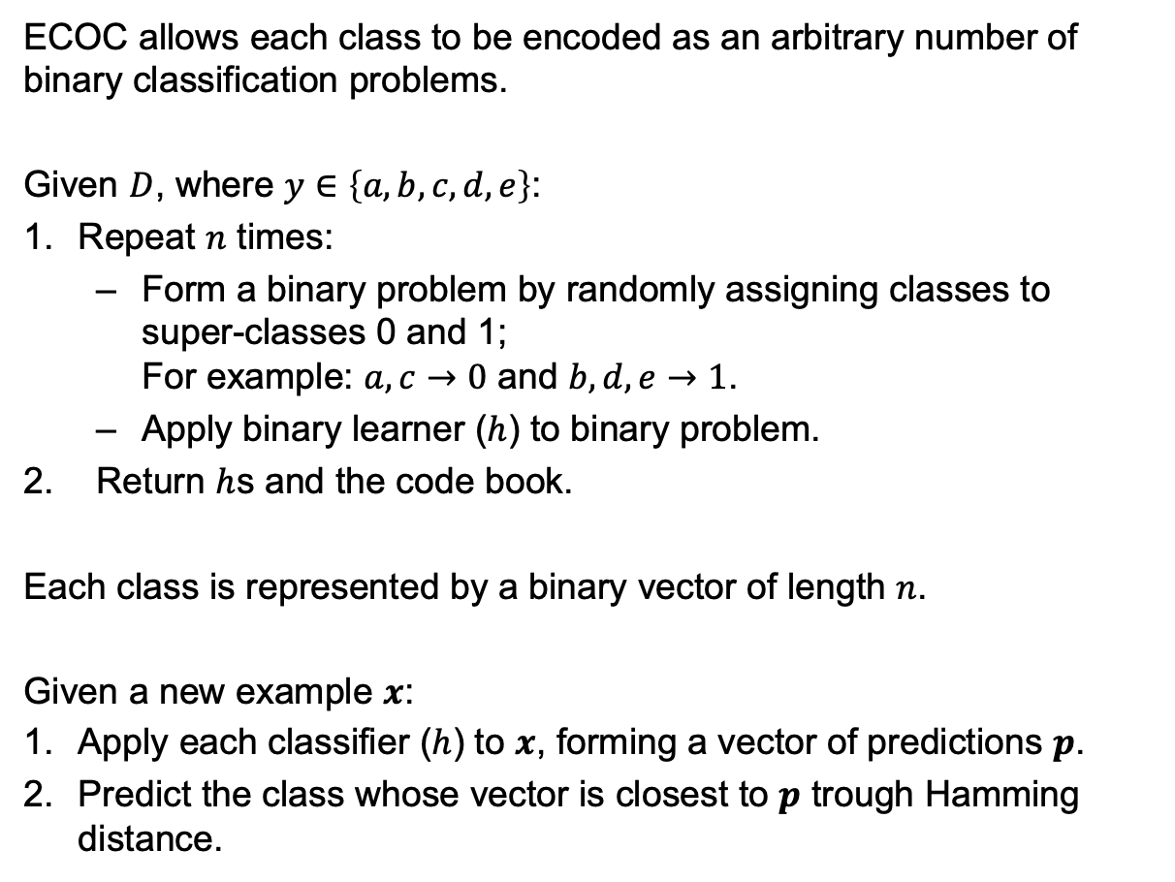

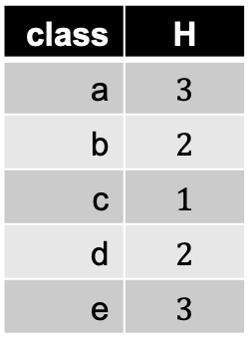
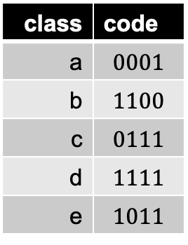
Error-Correcting Output Coding
ECOC allows each class to be encoded as an arbitrary number of binary classification problems.
Given $D$, where $y∈\left\{a, b, c, d, e\right\}$:
Repeat $n$ times:
Form a binary problem by randomly assigning classes to super-classes 0 and 1; For example: $a, c→0$ and $b,d,e→1$.
Apply binary learner ($h$) to binary problem.
Return $h$s and the code book.
Each class is represented by a binary vector of length $n$.
Given a new example $x$:
Apply each classifier ($h$) to $x$, forming a vector of predictions $p$.
Predict the class whose vector is closest to $p$ trough Hamming distance.
bits | 1 | 2 | 3 | 4
0 | $$\{a,c\}$$ | $$\{a, e\}$$ | $$\{a, b\}$$ | $$\{b\}$$
1 | $$\{b,d,e\}$$ | $$\{b, c,d\}$$ | $$\{c, d, e\}$$ | $$\{a, c, d, e\}$$
class | code
a | $$0001$$
b | $$1100$$
c | $$0111$$
d | $$1111$$
e | $$1011$$
class | H
a | $$3$$
b | $$2$$
c | $$1$$
d | $$2$$
e | $$3$$
$$p=0110$$

Slide 10
Summary
Learn several models and combine them;
Stacking: meta-learner;
Bagging: random resamples;
Boosting: weighted resamples;
ECOC: recode outputs.

